Slide 1
INFOSYS SPRINGBOARD | FINAL PRESENTATION
Failure Prediction AI
Startup & Project Risk Analyzer
TEAM C MEMBERS
Manas Ranjan Sahu
Lakshmi Bhavani Nakka
Md Salman Farsi
Muskan Anjum
Project Mentor: Sophiya S

Slide 2
AGENDA
Table of Contents
01
Project Statement
06
Tools Used
02
Introduction
07
Milestone 1: Market Intelligence
03
System Workflow
08
Milestone 2: Risk Assessment
04
Architecture Diagram
09
Milestone 3: Strategic Reasoning
05
Modules Implemented
10
Milestone 4: Cloud Deployment

Slide 3

01. THE FOUNDATION
Project Statement
Entrepreneurs and startups often invest significant resources without fully understanding risks. 90% of ventures fail due to poor market fit and intense competition.
Goal: Develop an intelligent decision-support platform providing data-driven insights to guarantee successful execution.

Slide 4



02. OVERVIEW
Introduction
Automated Scoring
Strategic Reasoning
Instant Dashboards
Eliminating subjective human bias entirely.
AI-generated risk mitigation pathways.
Real-time visual intelligence for VCs.

Slide 5



03. PROCESS
System Workflow
1. Collection
2. Market Intel
3. Risk Scoring
4. AI Reasoning
5. Final Output
Capture project metrics.
Analyze TAM & SAM.
Generate quant metrics.
Formulate strategies.
Render live dashboard.

Slide 6




04. STRUCTURE
Architecture Diagram
Presentation
Application
LLM Agent
Data Storage
Streamlit & HTML/CSS UI layer.
Flask Python routing & calculation.
Gemini strategic reasoning.
PostgreSQL persistent records.

Slide 7
05. EXECUTION
Modules Implemented
1. Idea Collection
2. Market Intelligence
3. Risk Assessment
Secure frontend forms to capture metrics.
Automated TAM, SAM, and SOM calculations.
Evaluating multi-pillar risks on 1-5 scale.
4. SWOT Analysis
5. AI Recommendations
6. Reporting System
Algorithmic deduction of strengths and threats.
Actionable mitigation via LangGraph.
Fully interactive cloud analytics dashboard.

Slide 8





06. TECHNOLOGY
Tools & Stack Used
Python
Flask & Streamlit
PostgreSQL
Core mathematical risk calculations.
API routing and interactive UI frameworks.
Relational schema for data persistence.
Google Gemini
HTML/CSS
Render PaaS
LLM empowering strategic reasoning.
Frontend markup for structure and design.
Cloud platform for live application deployment.

Slide 9
MILESTONE 1
Data Collection & Market Intelligence
Establishing the project foundation by securely capturing data and assessing initial market viability.
Metrics Achieved
Successfully collected and processed project information.
Market and competitor analysis generated correctly.

Slide 10



MILESTONE 1
Workflow & Implementation
Input Form
Data Storage
Automated Sizing
Frontend securely captures project budget and target market.
Raw metrics stored into PostgreSQL schemas instantly.
System evaluates demographics to calculate TAM, SAM, SOM.

Slide 11

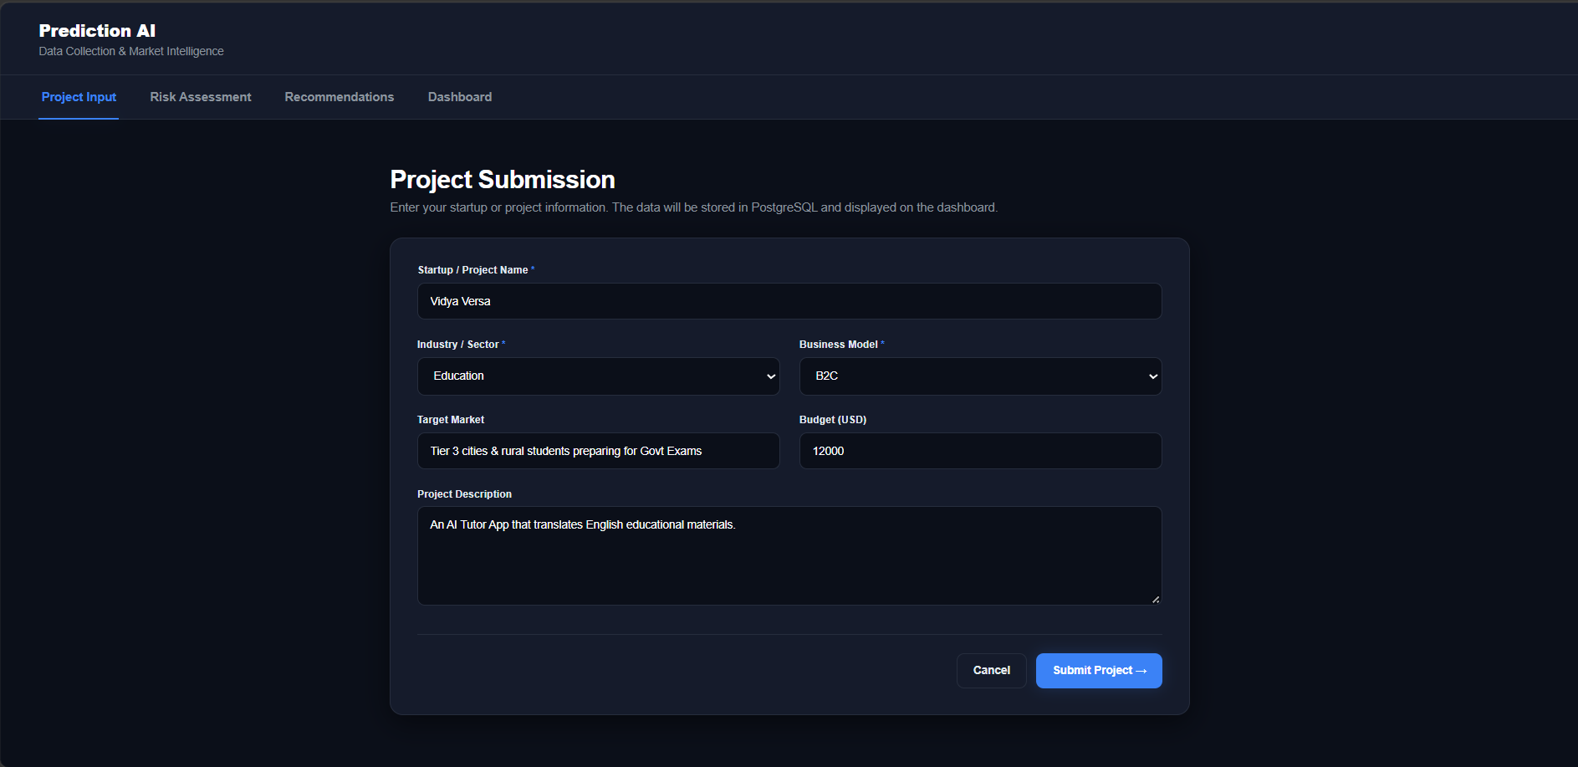
Milestone 1: Project Submission

Slide 12
MILESTONE 2
Risk Assessment
Transforming raw startup parameters into objective, mathematical feasibility metrics.
Metrics Achieved
Risk scoring model produces consistent evaluations.
SWOT analysis generated successfully for submitted projects.

Slide 13



MILESTONE 2
Workflow & Implementation
5-Point Risk Logic
Averaging Core
SWOT Deduction
Evaluating Financial, Technical, and Market risks on a 1-5 scale.
Python logic calculates conclusive Feasibility Percentage.
Algorithmic thresholds map directly to specific SWOT statements.

Slide 14
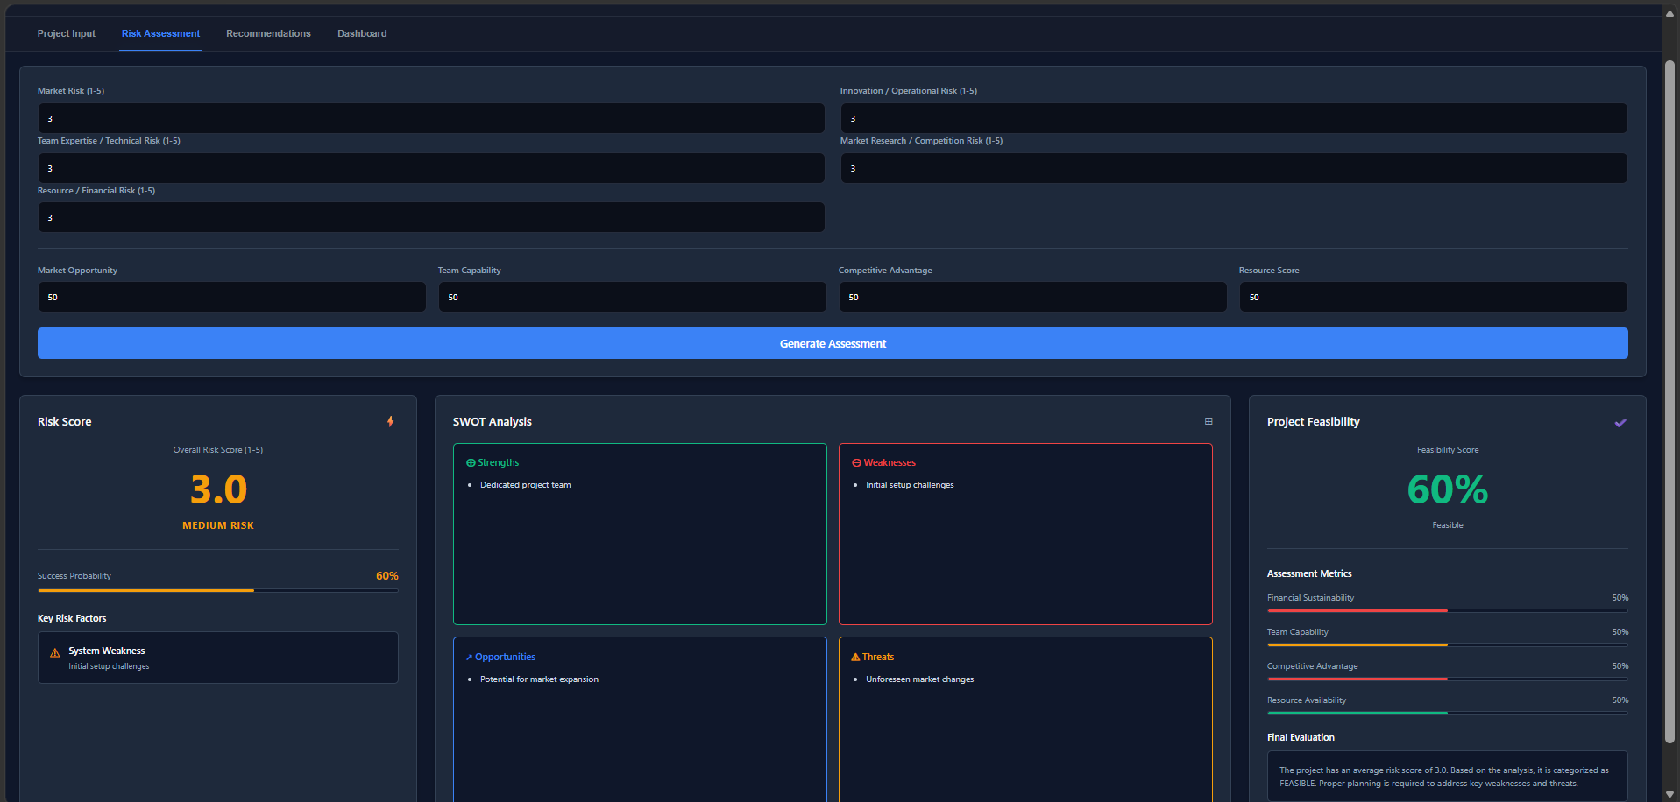
Milestone 2: Risk Assessment Dashboard

Slide 15
MILESTONE 3
Strategic Reasoning
Bridging the gap between static risk scores and dynamic business decisions using Generative AI (Gemini).
Metrics Achieved
AI recommendations logically align with identified risks.
Mitigation strategies generated successfully via LangGraph.

Slide 16


MILESTONE 3
LangGraph Agent Workflow
1. Ingestion
2. Analysis
3. Reasoning
4. Validation
5. Report Gen.
Collect project data.
Evaluate vulnerabilities.
Generate AI strategies.
Cross-check baseline data.
Compile final outputs.

Slide 17
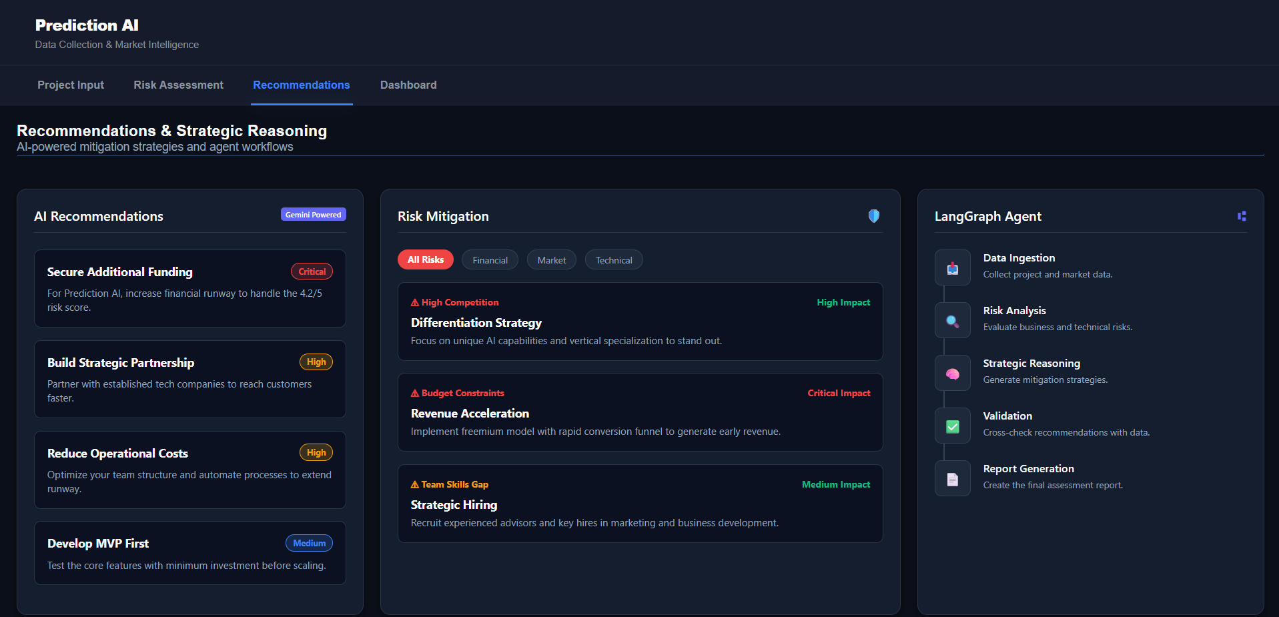
Milestone 3: AI Recommendations

Slide 18
MILESTONE 4
Dashboard & Deployment
Finalizing the live analytics dashboard and deploying the Python architecture to the cloud.
Metrics Achieved
Dashboard fully operational with end-to-end workflow.
Assessment reports generated well within 5 seconds.

Slide 19
MILESTONE 4
Deployment & Optimization
1. GitHub Integration
The Cold-Start Challenge
Version control and dependency management (requirements.txt).
Deploying on free tiers introduced a "sleep mode" bottleneck causing 50-second delays upon reactivation.
The Solution
2. Cloud Hosting
Integrated UptimeRobot to programmatically ping our endpoint every 5 minutes, guaranteeing 0s delay and 100% uptime.
Deploying the Python architecture via Streamlit Community Cloud.

Slide 20
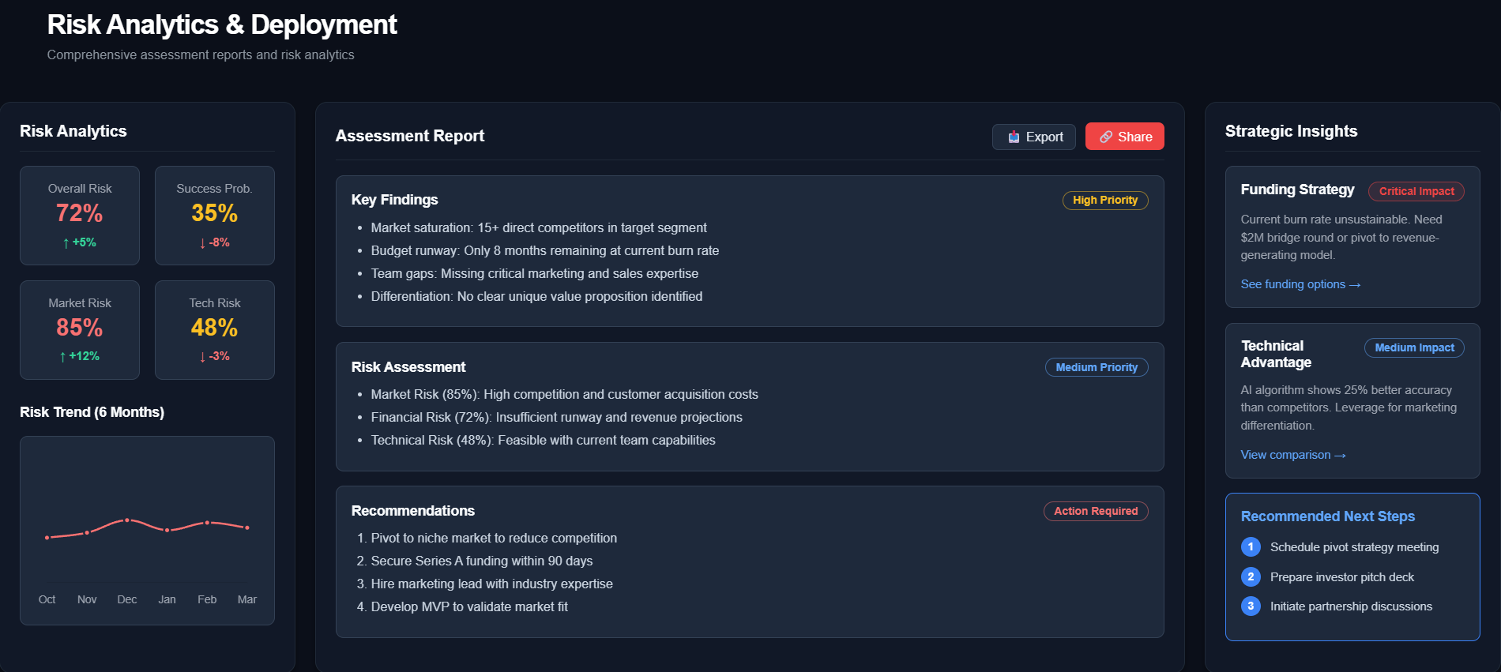
Milestone 4: Risk Analytics Dashboard

Slide 21
Validation Metrics
<5s
≥85%
Report Generation Time
User Satisfaction Score
Assessment reports are successfully generated within the 5-second benchmark.
Achieved required CSAT rating during system testing and evaluation.

Slide 22
Thank You
We are now ready for the Live Demonstration.
FAILURE PREDICTION AI | TEAM C

